Slide 1
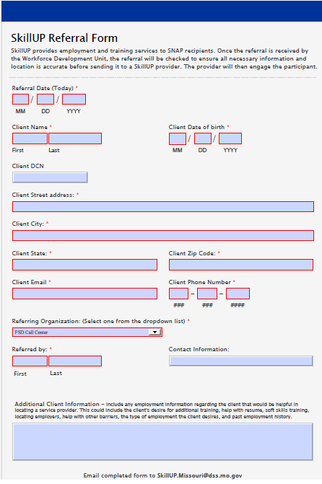
Submitting a partner referral
Take the following steps to send an employment and training referral:
Use the SkillUP referral form (right) – Complete the form offering as much detail as possible on your client.
If known, provide the client’s DCN.
Select your organization and provide your contact information.
If client is interested in other DSS Workforce programing, include as additional client information.
Email Partner Referral Form to SkillUP.Missouri@dss.mo.gov
We will reach out to the customer.

